Slide 1
Predicate Calculus aka First-Order Logic

Slide 2
The predicate calculus
Extends propositional logic in two ways:
Propositions are no longer atomic. They assert that an entity has a property or that a relation holds between entities
Universal quantifier: Every entity has a property. Existential quantifier: There exists an entity with a property.
All (or nearly all) mathematical statements can be expressed in the predicate calculus, and all proofs can be justified in the predicate calculus.
Many other forms of reasoning as well.

Slide 3
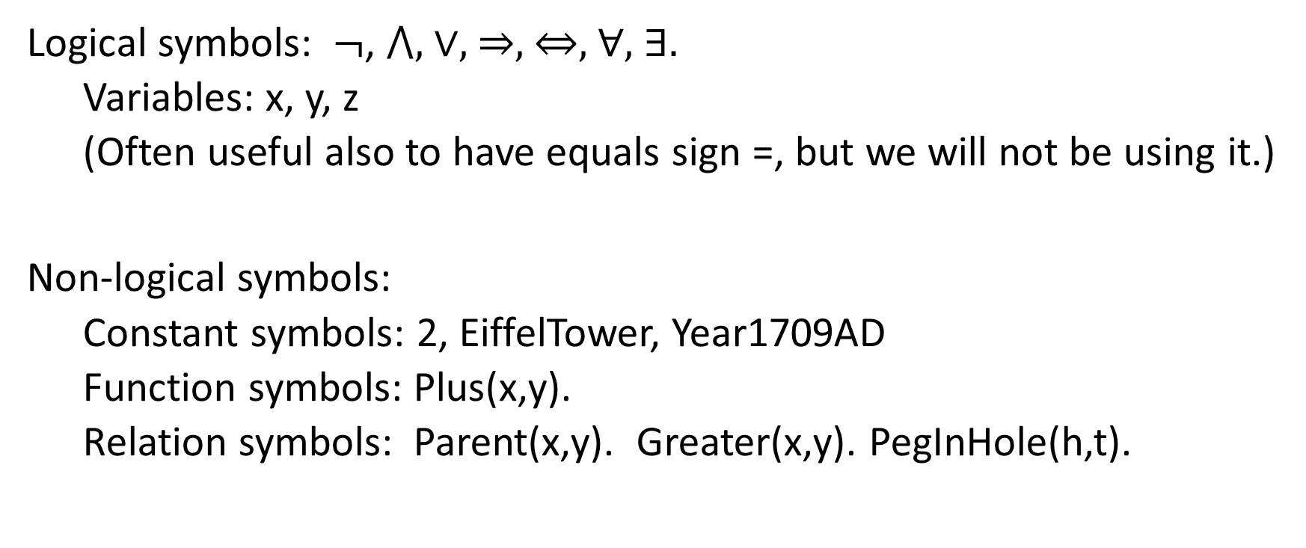
Syntax
Logical symbols: $¬$, ⋀, ∨, ⇒, ⇔, ∀, ∃.
Variables: x, y, z
(Often useful also to have equals sign =, but we will not be using it.)
Non-logical symbols:
Constant symbols: 2, EiffelTower, Year1709AD
Function symbols: Plus(x,y).
Relation symbols: Parent(x,y). Greater(x,y). PegInHole(h,t).

Slide 4
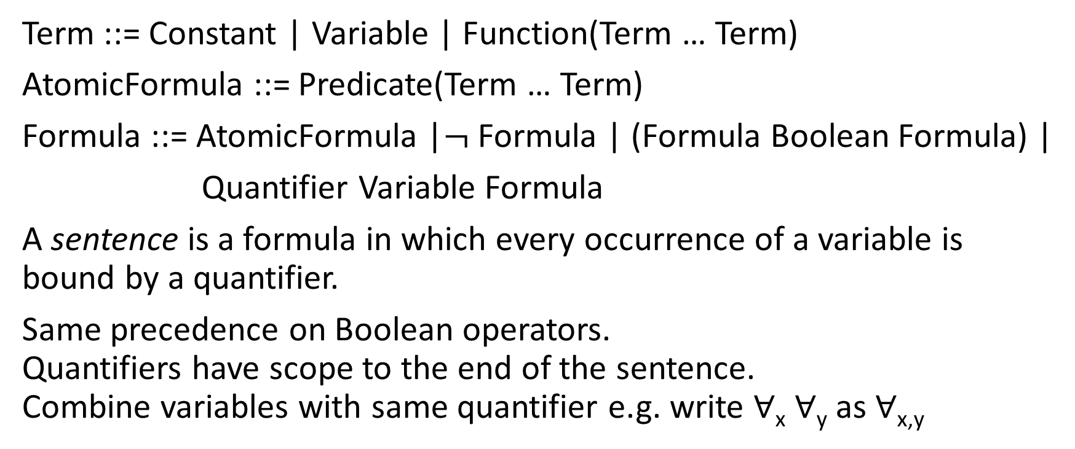
Syntax
Term ::= Constant | Variable | Function(Term … Term)
AtomicFormula ::= Predicate(Term … Term)
Formula ::= AtomicFormula |$¬$ Formula | (Formula Boolean Formula) |
Quantifier Variable Formula
A sentence is a formula in which every occurrence of a variable is bound by a quantifier.
Same precedence on Boolean operators. Quantifiers have scope to the end of the sentence. Combine variables with same quantifier e.g. write ∀_{x} ∀_{y} as ∀_{x,y}

Slide 5
The syntax of a sentence is a tree
F
F
F
F F
A A
T
T T T T T
Q V Q V P V V B P F V C V
∀ _{x} ∀ _{y} Gt( x , y) ⇒ Gt (Plus( x, One), y)

Slide 6
Semantics
There is a universe Ω of entities.
What kind of entities? Whatever you want: People, physical objects, organizations, numbers, units of time, regions of space …
But you decide at the start on your entities, and you stick to that.
∀_{x}α(x) means that all entities x have property α.
∃_{x}α(x) means that some entity x has property α.

Slide 7
Denotation of non-logical symbols
A constant symbol denotes an entity in Ω.
E.g. D(“Two”) = 2.
An n-place predicate symbol denotes a n-place relation over Ω; that is, a set of n-tuples of entities.
E.g. D(“Gt”) = {<x,y> | x > y} = { <2,1>, <5,3>, <4,1> … }
An n-place function symbol denotes a n-place mapping over Ω; that is, a set of (n+1)-tuples of entities where the last term depends functionally on the first n.
E.g. D(“Plus”) = { <x,y,z> | x+y=z} = {<1,1,2>, <2,3,5>, <8,1,9> …}

Slide 8
Tarskian semantics for predicate calculus
Given a first-order language L, the domain Ω, and the denotation of every non-logical symbol in L
The semantics for predicate calculus defines whether a given sentence is true or false.
However I’m not going to go into it.
Instead, I’ve going to give you some advice about correctly writing sentences in predicate calculus.

Slide 9
How to express facts in predicate calculus
Preliminary comments about translating from English to Pred. Calc.
If I specify a domain Ω and a language L (that is, a set of non-logical symbols and their meaning) and then ask you how an English sentence can be expressed in L, that can be a reasonable question. I will be asking you questions of this kind on problem sets and exams.
If I give you a subject matter and describe what kinds of facts I want to express and what kinds of reasoning I want to support, and ask you to design a language that expresses those facts and a theory that justifies the reasoning, that can be a reasonable question, but it is a large and difficult one. I won’t be asking you problems of that kind. That would be a term project in a course in knowledge representation.

Slide 10
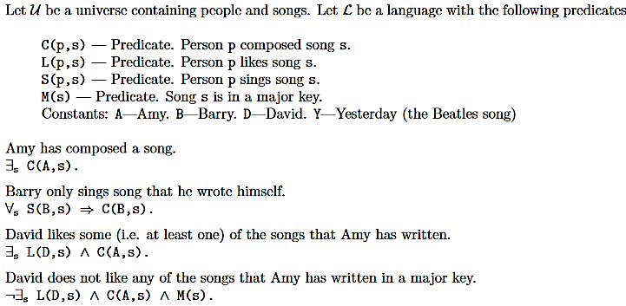
Examples: People and songs

Slide 11
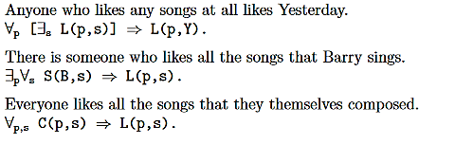

Slide 12
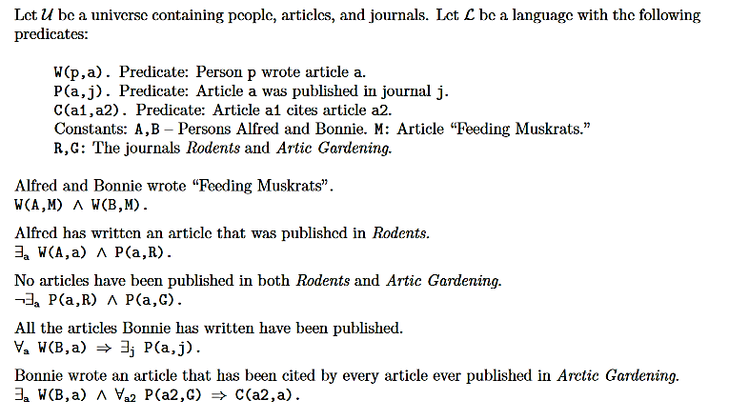
Example: People, articles, journals

Slide 13
There are no fixed rules for translating natural language to logic.
You have to think about the meaning of what the sentence says, and express that meaning in logic.
But there are certainly things to keep in mind and errors to avoid.

Slide 14
Observe the rule of syntax
Constants, functions, and variables are inside predicates.
Boolean operators and quantifiers are outside predicates.
Predicates are not inside one another.
“Sam has a male child”
WRONG!!! Male(∃_{x} Child(x,Sam))
WRONG!!! ∃_{x} Child(Male(x),Sam)
RIGHT: ∃_{x} Male(x) ⋀ Child(x,Sam)
“Mary and Ed are children of Anne.”
WRONG!!! Child(Mary ⋀ Ed, Anne)
RIGHT: Child(Mary,Anne) ⋀ Child(Ed,Anne)

Slide 15
Restricted universal quantification
“All crows are black”
RIGHT: ∀x Crow(x) ⇒ Black(x).
As stated before, α⇒β means “not α or β“.
So this means “Everything Is either not a crow or it is black”. So if some particular object is a crow, it must be black.

Slide 16
Restricted universal quantification
WRONG: ∀x Crow(x) ⋀ Black(x).
This means, “Everything is both a crow and black” “Everything is a black crow.”
In general, ∀_{x} α(x)⋀β(x) is equivalent to [∀_{x} α(x)] ⋀ [∀_{x} β(x).]
If everything is both α and β, then everything is α and everything is β.
If you’ve written a formula of the form ∀_{x} α(x)⋀β(x) where a conjunction is directly in the scope of a universal formula, there is a 95% chance you’ve written it wrong. To check, rewrite as [∀_{x} α(x)] ⋀ [∀_{x} β(x)], and see whether it still looks plausible.

Slide 17
Restricted existential quantification
“Some ducks are white.”
RIGHT: ∃_{x} Duck(x) ⋀ White(x)
(except that the plural is lost).
This means “There is something that is both a duck and is white.”
“Some white things are ducks” would be represented the same way, but that’s OK.

Slide 18
Restricted existential quantification
“Some ducks are white.”
WRONG: ∃_{x} Duck(x) ⇒ White(x)

Slide 19
Restricted existential quantification
“Some ducks are white.”
WRONG: ∃_{x} Duck(x) ⇒ White(x)
WRONG!

Slide 20
Restricted existential quantification
“Some ducks are white.”
WRONG: ∃_{x} Duck(x) ⇒ White(x)
WRONG!
WRONG!!!!

Slide 21
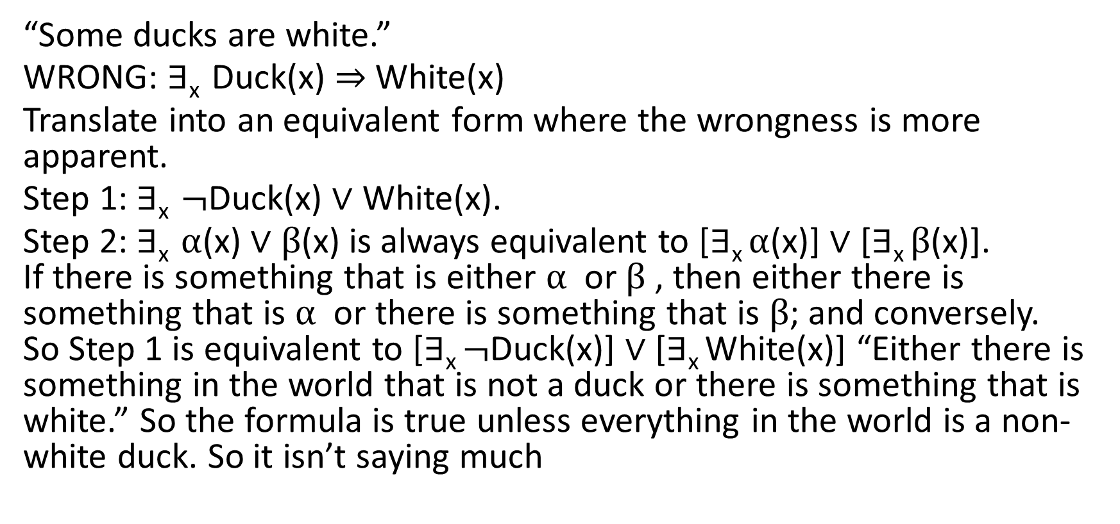
Restricted existential quantification
“Some ducks are white.”
WRONG: ∃_{x} Duck(x) ⇒ White(x)
Translate into an equivalent form where the wrongness is more apparent.
Step 1: ∃_{x} $¬$Duck(x) ∨ White(x).
Step 2: ∃_{x} $α$(x) ∨ β(x) is always equivalent to [∃_{x} $α$(x)] ∨ [∃_{x} β(x)]. If there is something that is either $α$ or β , then either there is something that is $α$ or there is something that is β; and conversely. So Step 1 is equivalent to [∃_{x} $¬$Duck(x)] ∨ [∃_{x} White(x)] “Either there is something in the world that is not a duck or there is something that is white.” So the formula is true unless everything in the world is a non-white duck. So it isn’t saying much

Slide 22
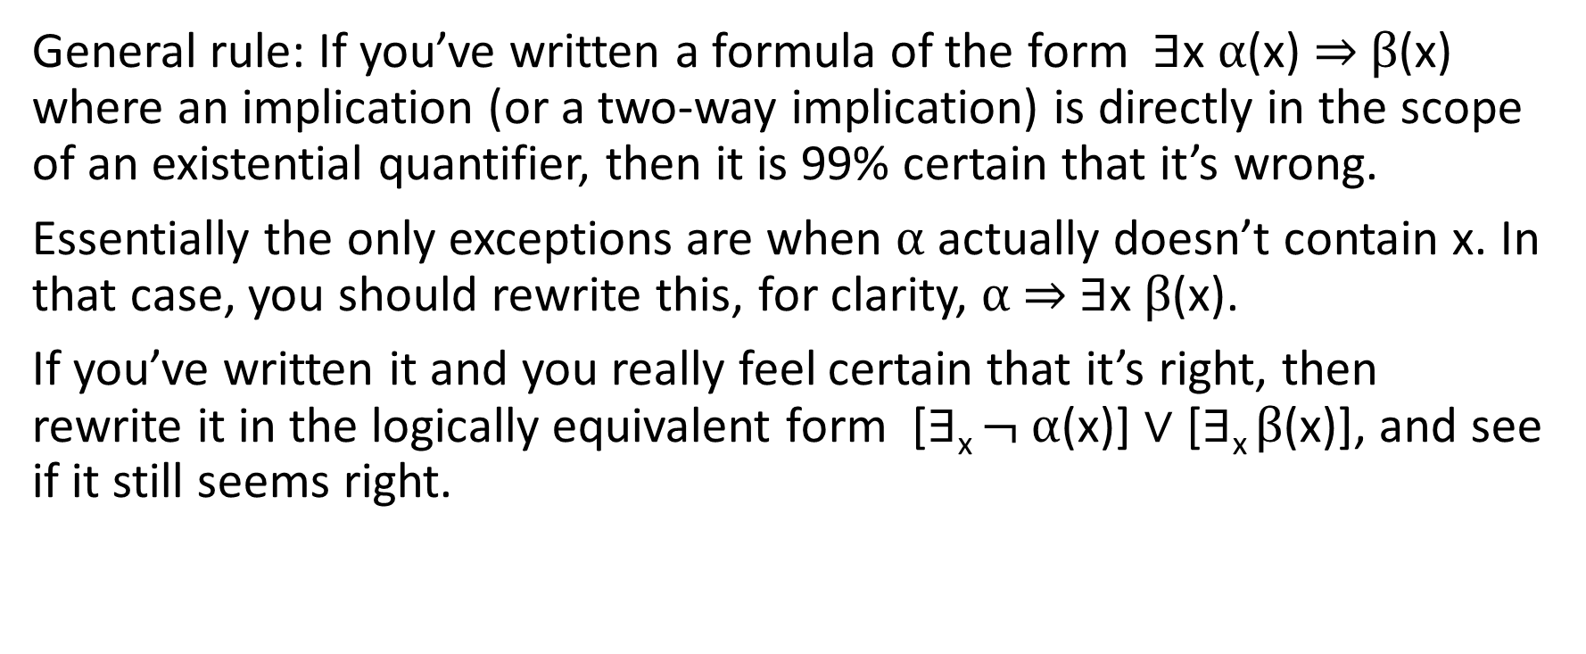
Restricted existential quantification
General rule: If you’ve written a formula of the form ∃x α(x) ⇒ β(x) where an implication (or a two-way implication) is directly in the scope of an existential quantifier, then it is 99% certain that it’s wrong.
Essentially the only exceptions are when α actually doesn’t contain x. In that case, you should rewrite this, for clarity, α ⇒ ∃x β(x).
If you’ve written it and you really feel certain that it’s right, then rewrite it in the logically equivalent form [∃_{x} $¬ α$(x)] ∨ [∃_{x} β(x)], and see if it still seems right.

Slide 23
Don’t trust the English! Quantifiers
“Some”, “Somebody” “Something”, “a”, “the” often mean an existential quantifier:
“George sees a robin.” ∃_{x} Sees(George,x) ⋀ Robin(x). “Someone’s knocking at the door” ∃_{x,y} Door(y) ⋀ KnockingAt(x,y).

Slide 24
Don’t trust the English! Quantifiers
But not always.
“If someone is 18 years old, they are allowed to vote.”
∀_{x} Geq(AgeOf(x),Times(18,Year)) ⇒ Legal(Do(x,Vote))
NOT: ∃_{x} Geq(AgeOf(x),Times(18,Year)) ⋀ Legal(Do(x,Vote))
(“There is someone over 18 who is allowed to vote”)
DEFINITELY NOT: ∃_{x} Geq(AgeOf(x),Times(18,Year)) ⇒ Legal(Do(x,Vote))
(Discussed earlier: This means “Either there is someone at least 18, or there is someone who may legally vote”)
NOT ANY BETTER: [∃_{x} Geq(AgeOf(x),Times(18,Year))] ⇒ Legal(Do(x,Vote))
(This means: If anyone is at least 18, then x may vote.

Slide 25
Don’t trust the English! Quantifiers
“A squirrel is a mammal”.
∀_{x} Squirrel(x) ⇒ Mammal(x)
“A person is allowed to drive only if they have a license.”
∀_{x} Legal(x,Drive) ⇒ ∃_{y} License(y) ⋀ Owns(x,y).
“Lucy owns a parrot that is larger than a cat.”
∃_{x} Parrot(x) ⋀ Owns(Lucy,x) ⋀ ∀_{y} Cat(y) ⇒ Larger(x,y)

Slide 26
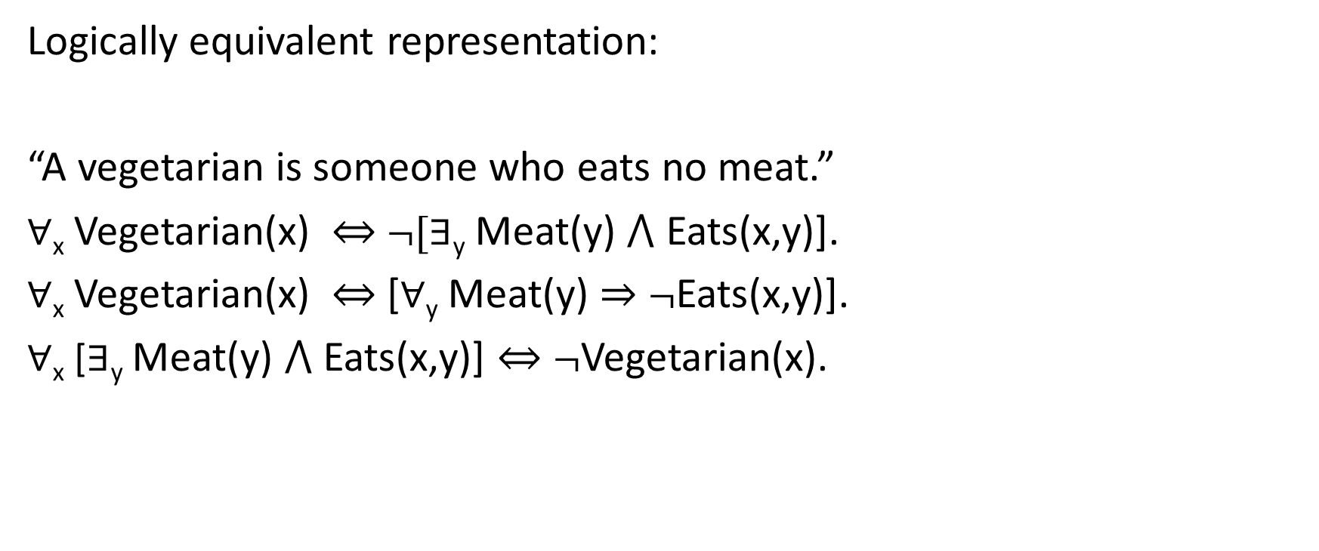
Alternative correct representations
Logically equivalent representation:
“A vegetarian is someone who eats no meat.”
∀_{x} Vegetarian(x) ⇔ $¬$[∃_{y} Meat(y) ⋀ Eats(x,y)].
∀_{x} Vegetarian(x) ⇔ [∀_{y} Meat(y) ⇒ $¬$Eats(x,y)].
∀_{x} [∃_{y} Meat(y) ⋀ Eats(x,y)] ⇔ $¬$Vegetarian(x).

Slide 27
Alternative correct representations
Logically equivalent given some background knowledge:
“Pamela has a long nose.”
Is this
∀x NoseOf(y,Pamela) ⇒ Long(y).
or
∃x NoseOf(y,Pamela) ⋀ Long(y).
or other possibilities?
Given that a person has one nose, these are equivalent.

Slide 28
Alternative correct representation
“Alabama borders Mississippi”.
Is this
Borders(Alabama,Mississippi) or
Borders(Mississippi,Alabama) or
Borders(Alabama,Mississippi) ⋀ Borders(Mississippi,Alabama)
Given the background knowledge that “Borders” is symmetric, these are equivalent.

Slide 29
In designing a language, do not shortchange the representation!
Especially: If you need to represent things that change over time, you will have to incorporate an explicit representation of time.
∀_{x} Light(x) ⋀ Off(x) ⋀ Flip(SwitchOf(x)) ⇒ On(x). WRONG.
∀_{x,t,t2} Light(x) ⋀ Off(x,t) ⋀ Occurs(t,t2,Flip(SwitchOf(x)) ⇒ On(x,t2).
Or some such.
It’s also the case that you don’t want to introduce more distinctions than you need. But of course, it’s hard to judge what you may need in the future.

Slide 30
Largely outside the scope of the predicate calculus
Generic statements: “Birds can fly. “
Vagueness: “Sarah is tall.”
Uncertainty. “It will probably take less than an hour to get to the airport.”
Modal operators: “John knows that Salem or Portland is the capital of Oregon.”
Meta-reasoning: “Hint: To solve problem 2.1, use the fundamental theorem of the calculus.”

